Slide 1

Accurate Virus-Bacteria Classification from Metagenomic Sequences Using Protein Language Models
Notes:
J: 1-7 17-24
R: 8 -16
Virus host interactions are protein-protein interactions that is one main reason why we embed protein sequences instead of genome

Slide 2







Our team
J. Cesar Espinoza, PhD
KGI Assistant Professor of Bioinformatics and Data Analytics
Ryan Fue
Joshua Barrow
UCLA Mathematics of Computation Student
UCI Computer Science Student
ryanfue@ucla.edu
barrowj@uci.edu

Slide 3
Content overview
1
2
3
Bacteria and Virus Genomics
Methodology
Machine Learning Models
4
5
Differentiating between Binary Classifiers
Future Plans and Conclusion
Notes:
Important of bacteria
Virus are important bc they bacteria
How virus currently seq and why this fails
Introduce LLMs as a solution
What is an LLM
How is an LLM applied specifically to our research
Current Progress
Future Goals
Acknowledgements

Slide 4
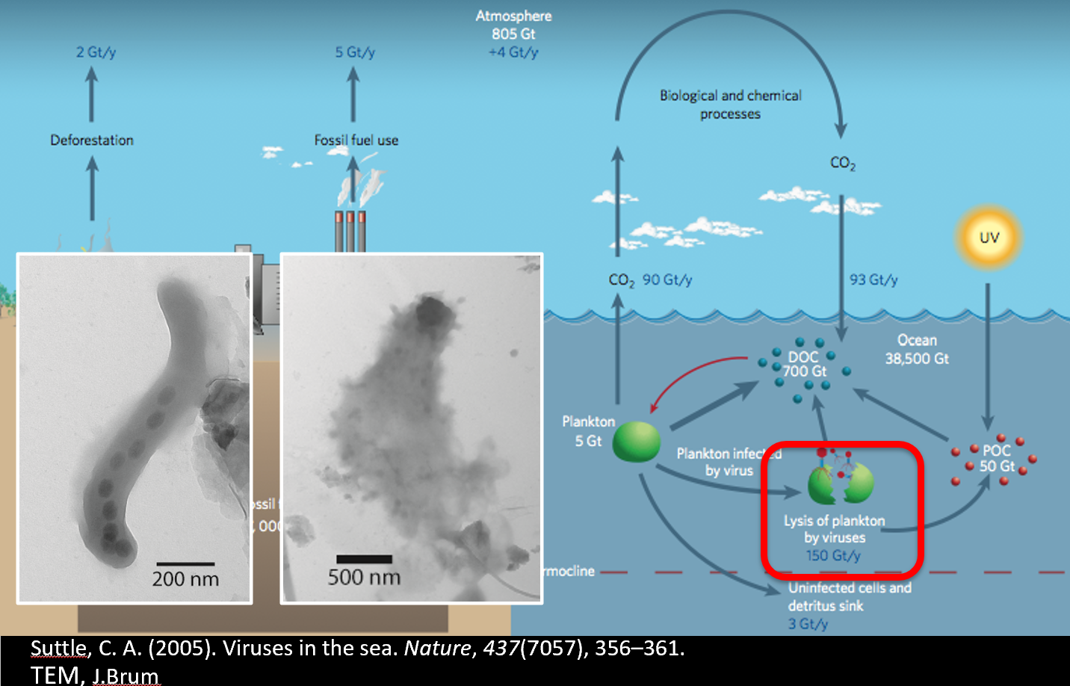

The importance of Bacteria and Viruses
5x10³⁰ Bacteria on Earth
Bacteria/Virus Relationships
https://www.worldatlas.com/how-much-bacteria-is-on-earth.html
Notes:
Human gut health
Nutrients cycling
Nitrogen fixation

Slide 5
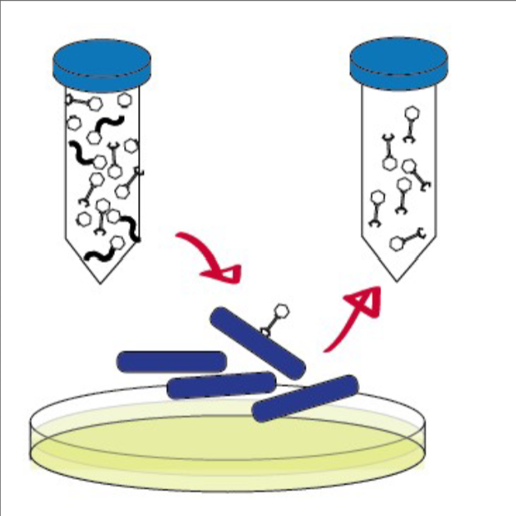
Current Limitations
Bacteria/Virus Relationships
1
Viruses affect the evolution of bacteria
2
Current methods to isolate viruses are limited
3
Cultivation Bias prevents classification

Slide 6

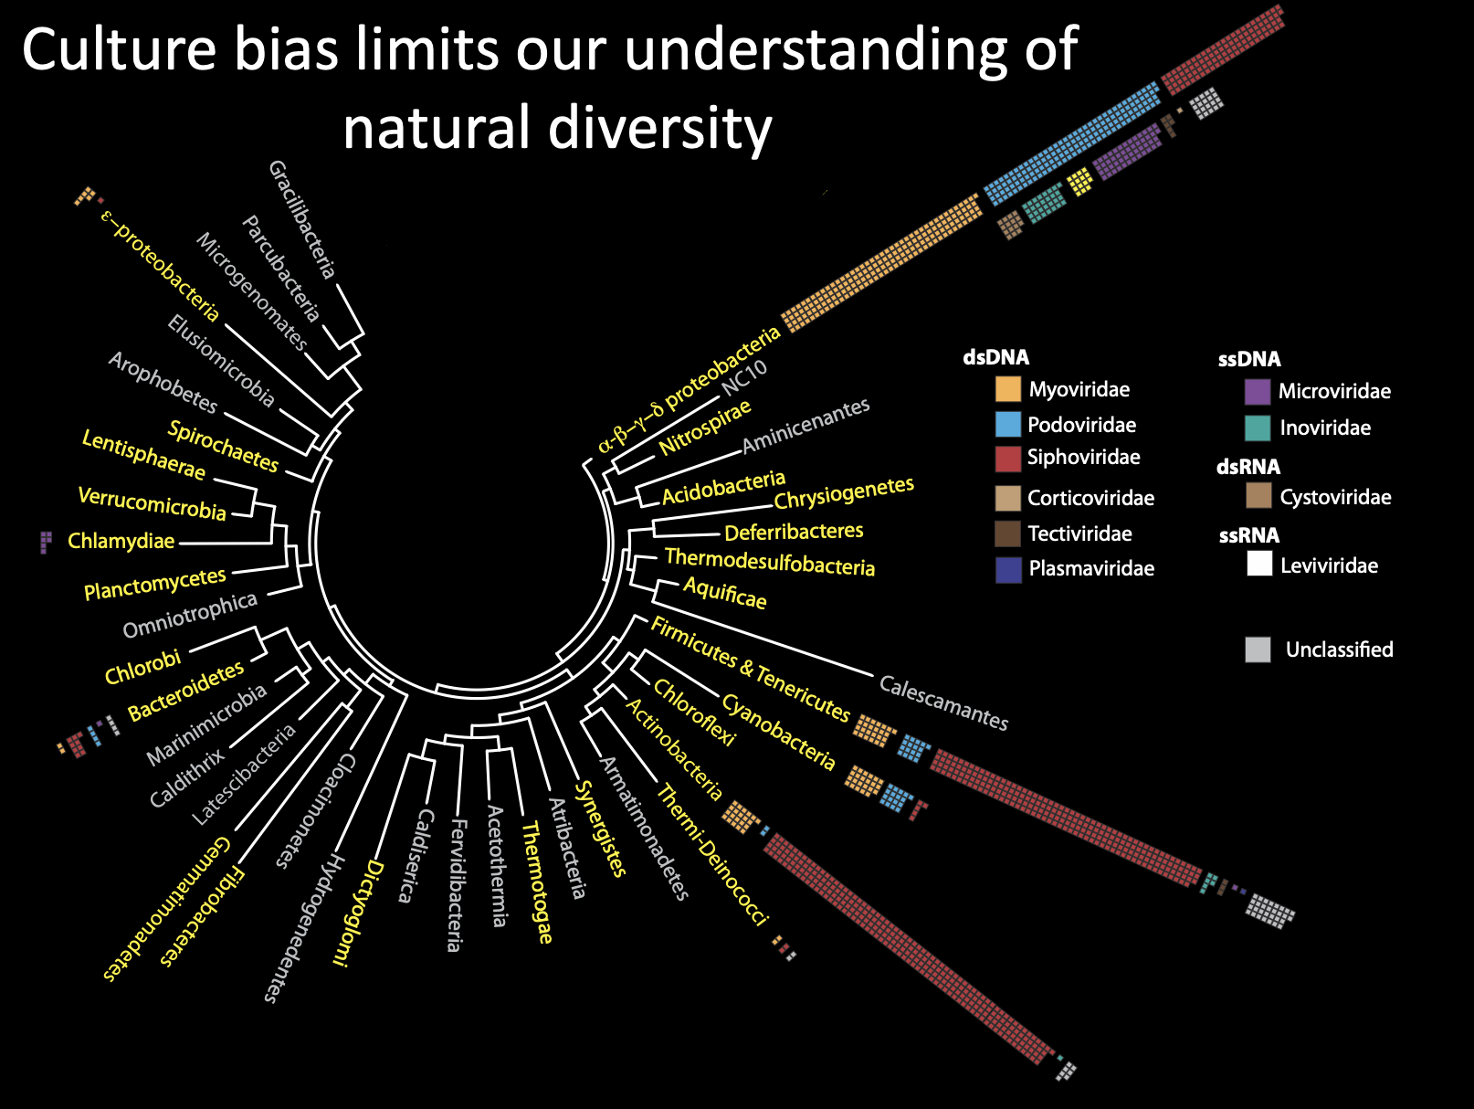
How much do we know?
Bacteria/Virus Relationships
Notes:
Only certain bacteria can be cultured
Limits our ability to study viruses
Each name is a bacteria phyla - > the boxes are viruses (EMPHASIZE ONLY CLUSTER IN SPECIFIC PHYLA)

Slide 7
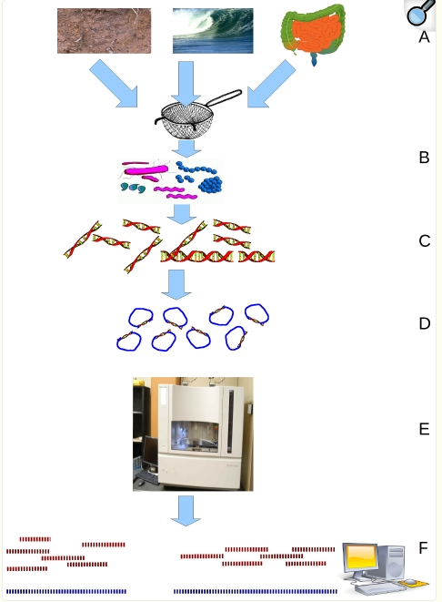
What is Metagenomics?
Genetic information is collected from an environment
Sequenced then analyzed after using processing methods
Wooley JC, Godzik A, Friedberg I. A primer on metagenomics. PMID: 20195499
Notes:
We dont get full genomes -> piece together puzzle from chunks of puzzle

Slide 8
80M+ database
entries
4M parsed
entries
Python, Bash, SQL
Methodology
Notes:
High-Resolution Classifier
Accurately determine the taxonomy of a viruses or bacterias in a metagenomic sample

Slide 9
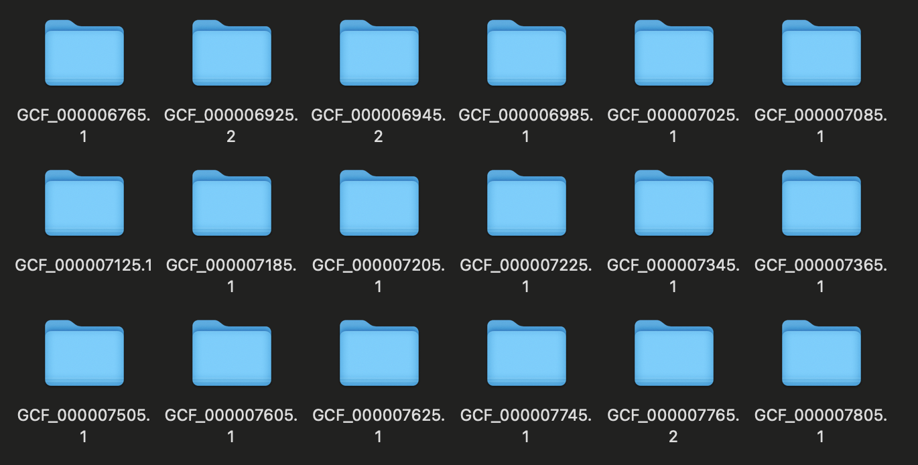
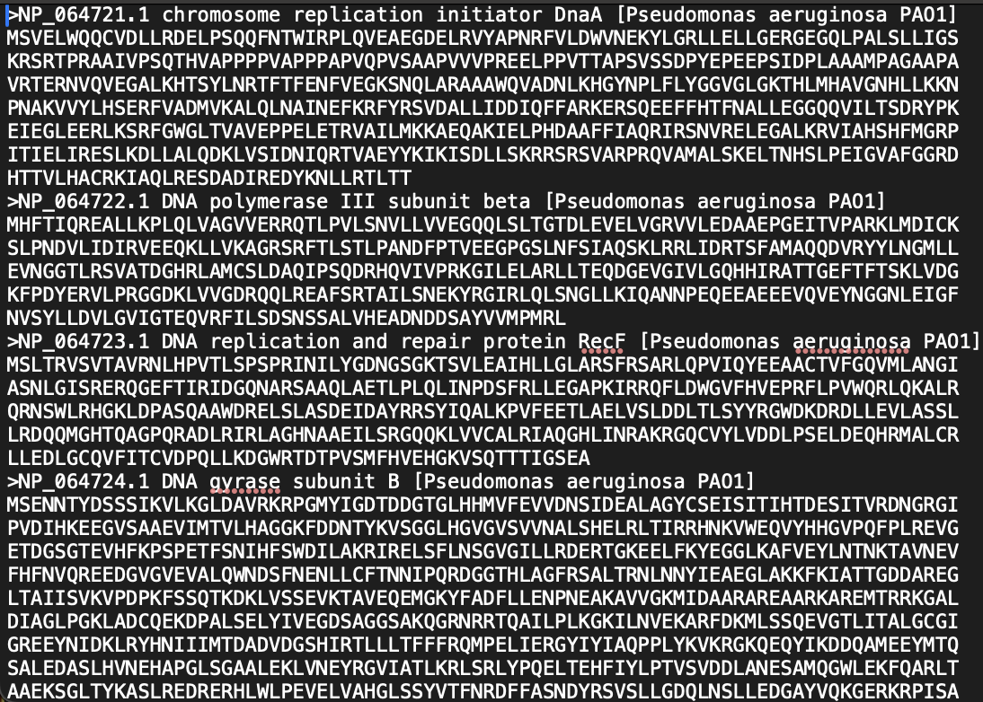
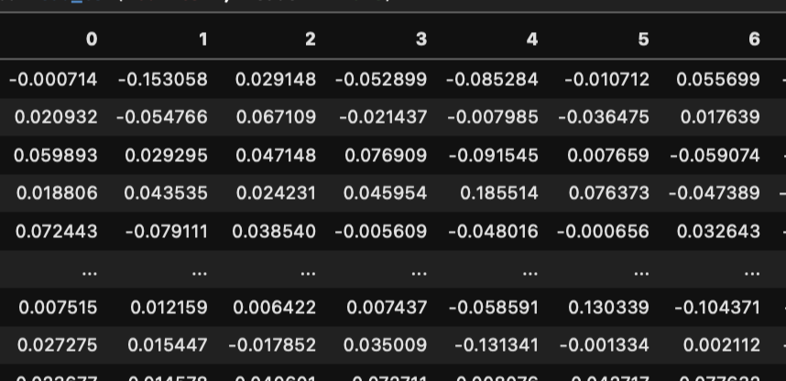
Genome Id
Data collected from the NCBI and Virus-Host Database
Protein Id
Extract fasta file
Taxonomic Label
2. Table entries parsed from FASTA files and filtered to 2M entries
Protein Sequence
Convert protein sequences into vectors using ESM Metagenomic Atlas
3. Virus/bacteria protein sequences embedded into vectors
Notes:
Talk about Laguna

Slide 10
4. Filter out similar protein sequences
(80%) using MMseqs2 to reduce bias when split into testing and training
Training Set (80%)
Testing Set (20%)
Similar Sequences
95% Representative Seq
5. Split aggregated genome level embeddings into training (80%)
and testing set (20%)
MVRDLAAALEEARLWAAKEGADEILW
MVRDLAAALEEERLWAAKEAADEIAV
MVRDLAAALEEERLWAAKEAADEIAV
AVRDLAAALEEARLWAAKEGADEIAV
6. Train machine learning models on
genome level embeddings
7. Revert testing set into protein level
embeddings to perform sensitivity
analysis/ROC and determine best model
Genome Label
Protein Label
WP_419335103.1
GCF_965178695.1
WP_419335363.1
Notes:
Talk about Laguna

Slide 11
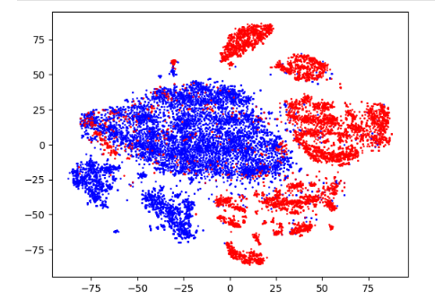
II
Virus and Bacteria Clustered (80%) Mean Embeddings by Genome ID
Virus
Bacteria
Notes:
Emphasize the significance of clustering more
This shows there are clusters
Despite being clustered by Genome ID which removes a lot of information, clusters are still visible despite this simplification of the data. Not one big blob of data
-> Can use ml to split data

Slide 12
Machine Learning Models

Slide 13
K Nearest Neighbor
K=5
4 Red
1 Blue
Classification: Red
Notes:
Important of bacteria
Virus are important bc they bacteria
How virus currently seq and why this fails
Introduce LLMs as a solution
What is an LLM
How is an LLM applied specifically to our research
Current Progress
Future Goals
Acknowledgements

Slide 14
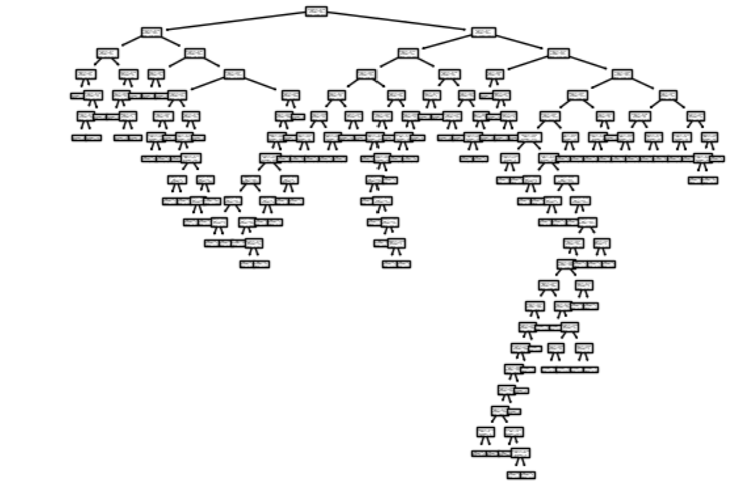
Tree/Random Forest Using Binary Classifiers

Slide 15
Logistic Regression
Virus (1)
P(Virus)
Unknown Sample
Bacteria (0)
Embedding based Value
Notes:
Generalitzation

Slide 16
SVC with Linear Kernel
Linear kernel: a hyperplane splits the data to create a soft margin
Performs well in high-dimensional applications
Notes:
Support vector classifier

Slide 17
Differentiating between Binary Classifiers

Slide 18
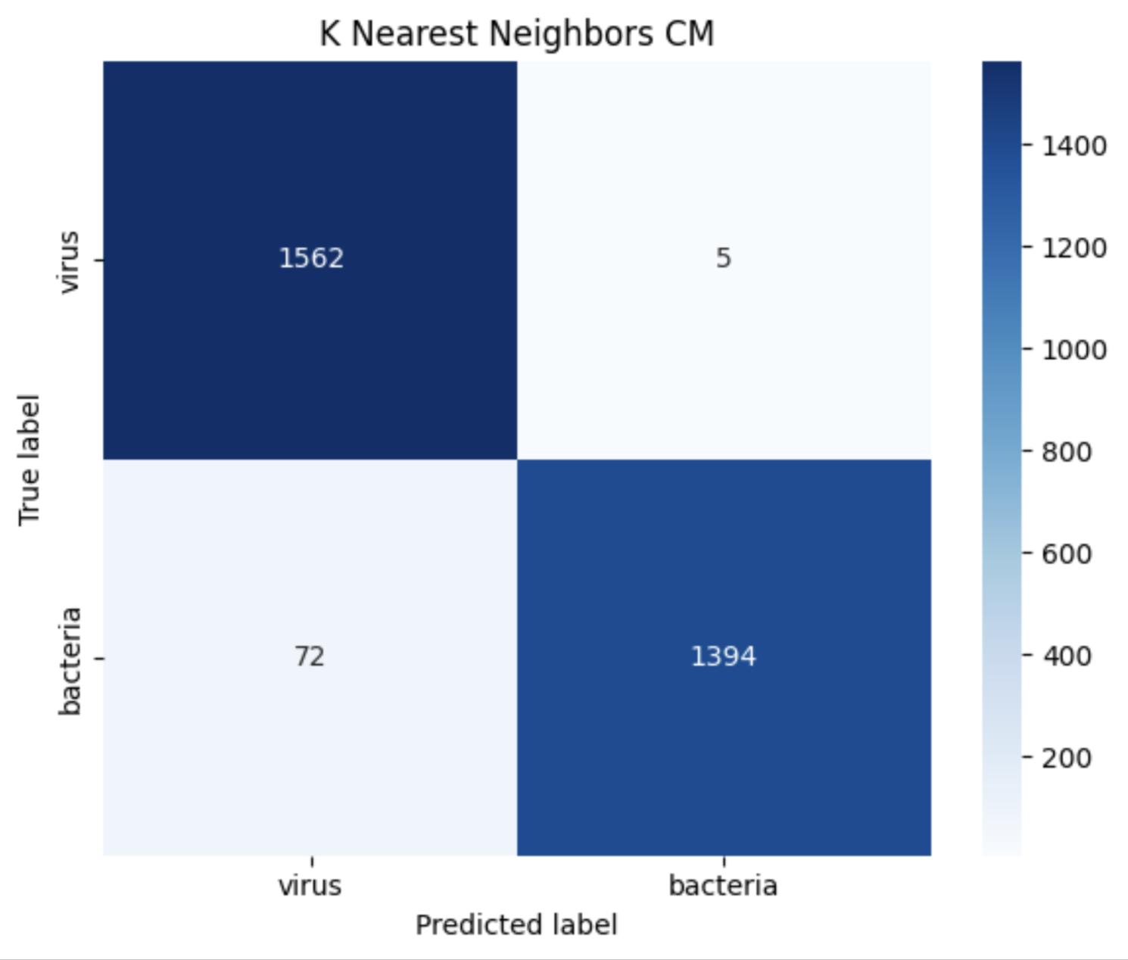

Slide 19
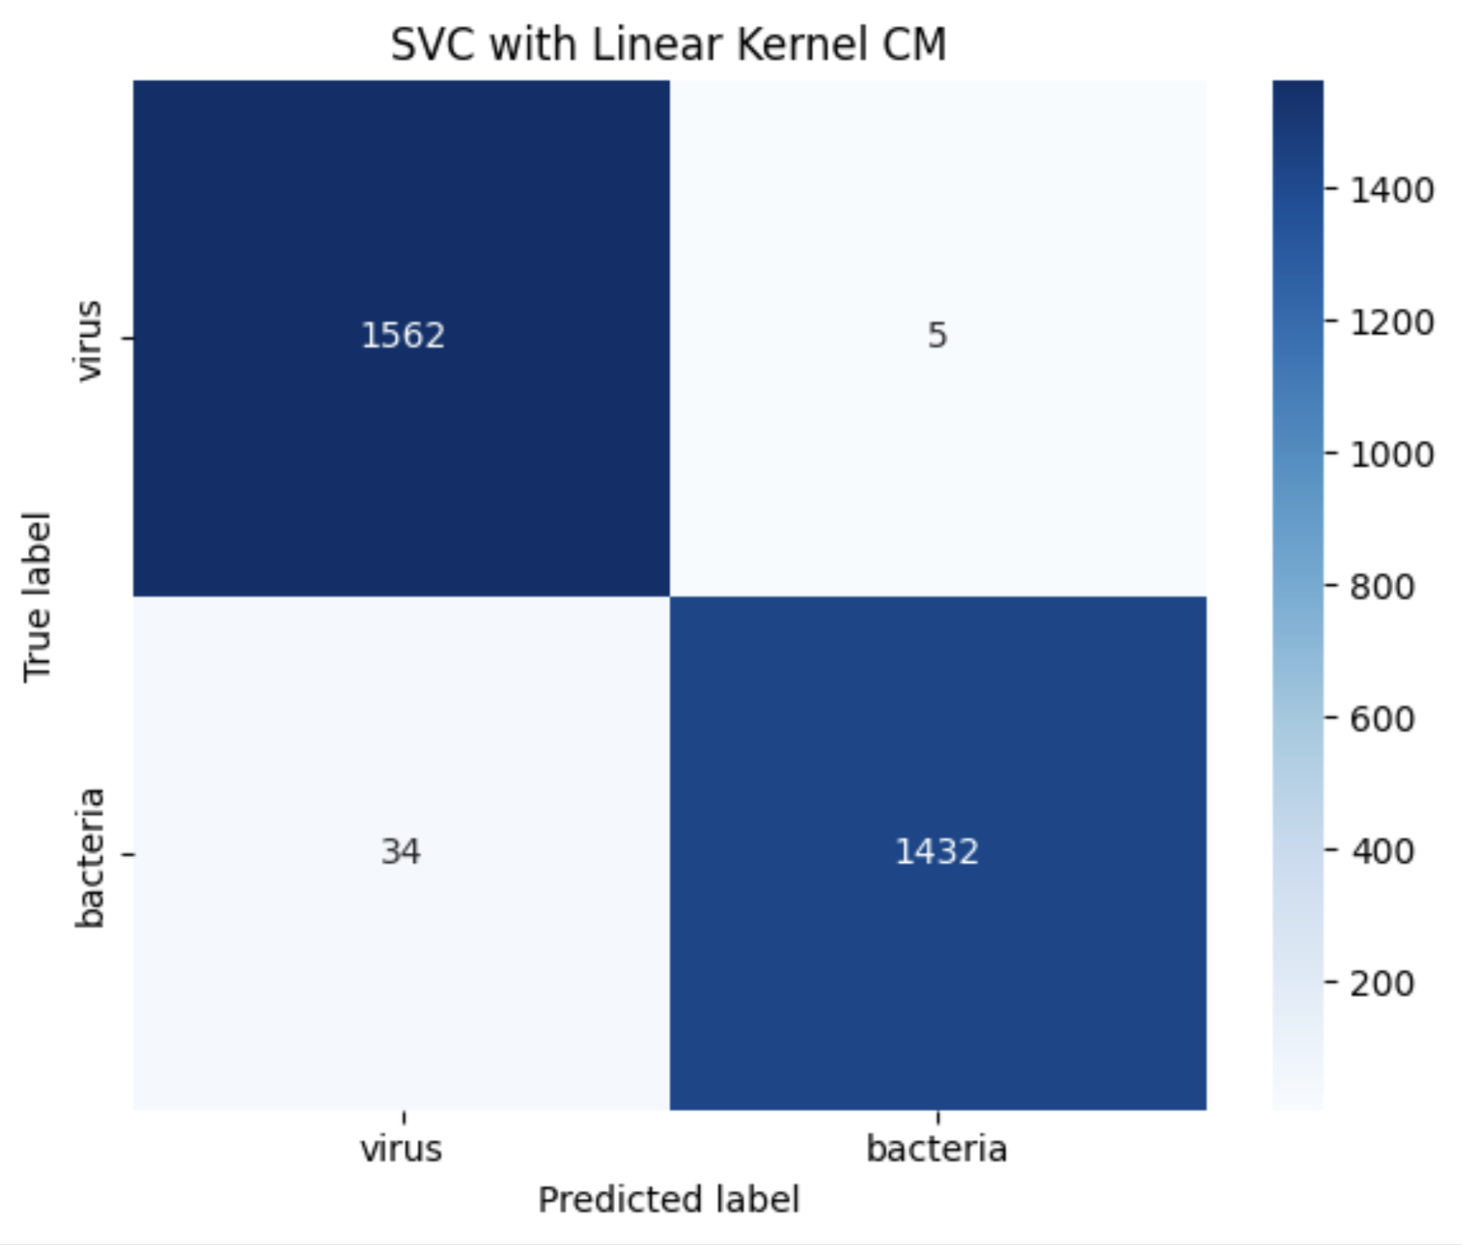
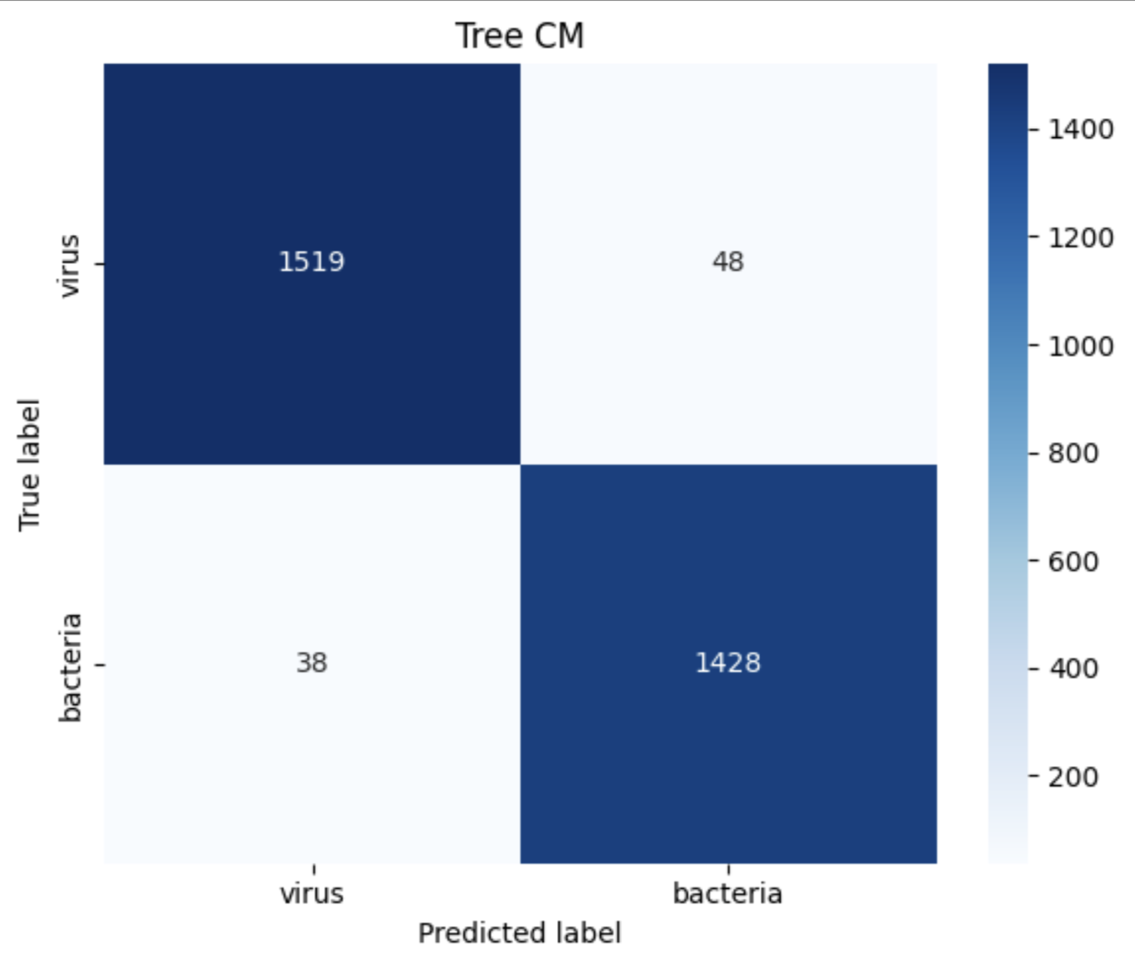


Notes:
All genome level does well so why sens

Slide 20
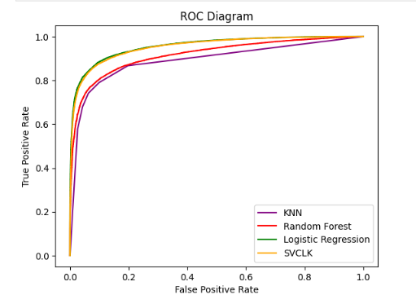
Test Diagnostics
Notes:
What are the most accurate models, graphical representation of the confusion matrixes. Logistic Regression and SVC Linear Kernal models are most accurate

Slide 21
Sample
Full Sequence
Notes:
We know they’re accurate logistic regression, and svc linear kernel approach high accuraccies with small amounts of protein sequences
Our focus is not only accuracy because all models eventually become very accurate. What we want is the most accurate with the least amount of information

Slide 22
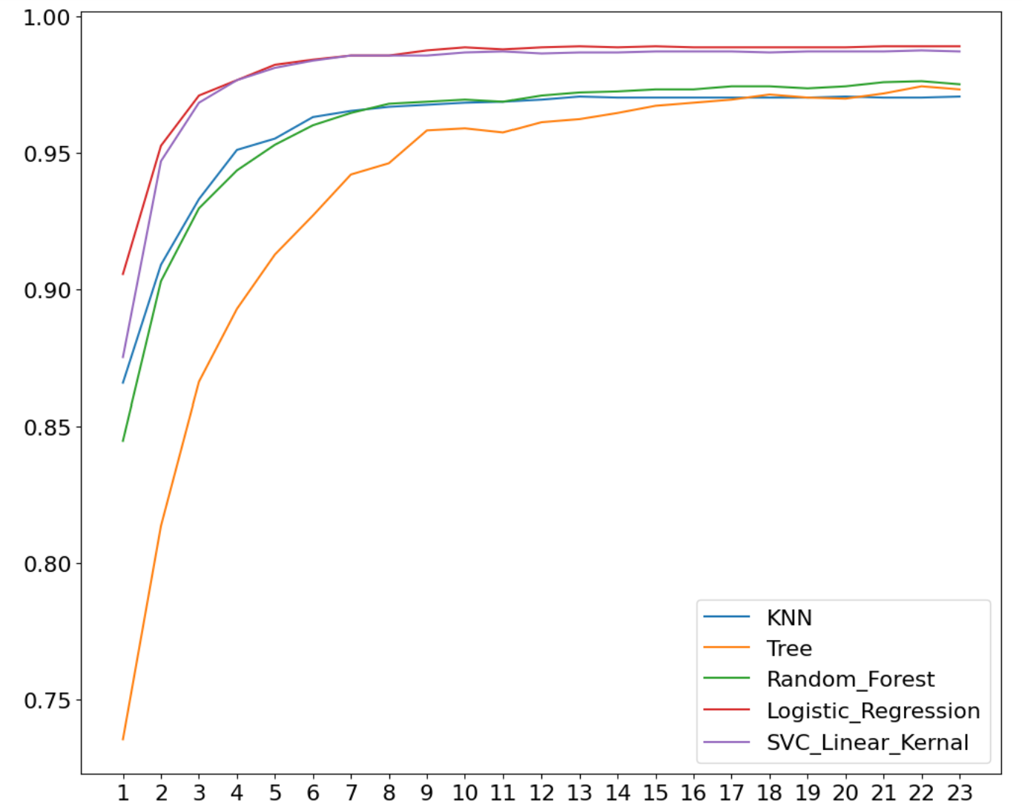
Line Graph of Classification Algorithms
Accuracy Percentage
Amount of Sequences
Notes:
We know they’re accurate logistic regression, and svc linear kernel approach high accuraccies with small amounts of protein sequences
Our focus is not only accuracy because all models eventually become very accurate. What we want is the most accurate with the least amount of information

Slide 23
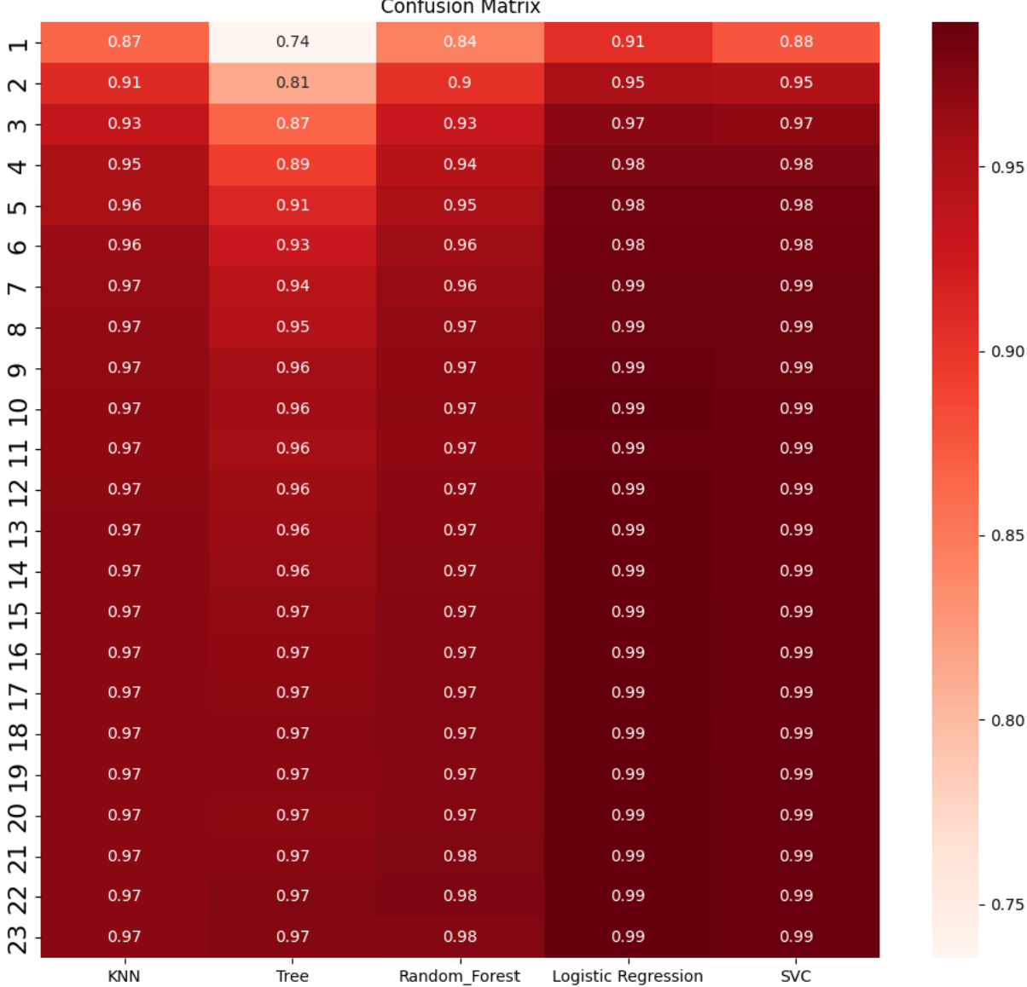
Heat Map of Classification Models
Amount of Sequences
Classification Models
Notes:
Usually get small pieces with metagenomics so sens is important

Slide 24
Future Plans
Promote Explainability
Use an Large Language Model for more precise classification
Extension to Novel/Unclassified Contigs.
Reduce bias in the model
✅
01
02
03
04
Notes:
Bias
More granularity
Examine a more stratified sample
Look at different data sets
Test modell against bacteria/virus with less relation to test set

Slide 25
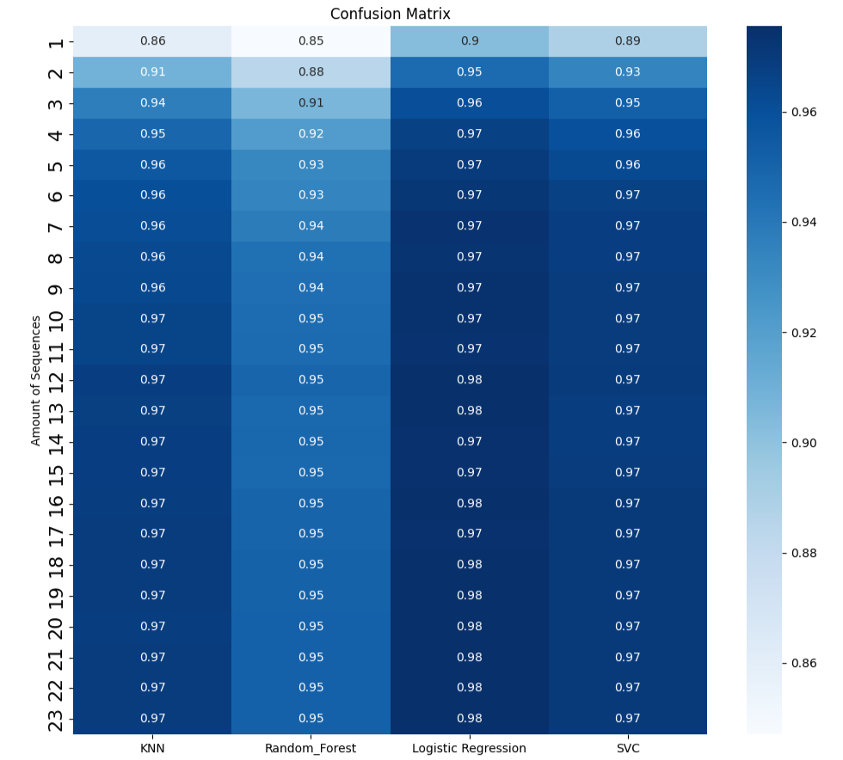
Heat Map of Classification Models of 80% Clustered Sequences
Amount of Sequences
Classification Models
Notes:
Usually get small pieces with metagenomics so sens is important

Slide 26

Acknowledgements
Professor Cesar Espinoza (mentorship and guidance) and Professor Angelika Niemz (SURE program and guidance)
Virus-Host DB and the NCBI (data base)
ESM Metagenomic Atlas (embedding tool for protein sequences)
KGI (funding) and USC Laguna computing servers (faster data processing)
Notes:
-Acknowledge Cesar, Virus-Host DB and ESM Metagenomic Atlas for data

Slide 27
Thank you

Slide 28
How do LLMs work?
Large Language Models

Slide 29
How much do we know?
Bacteria/Virus Relationships
Notes:
Only certain bacteria can be cultured
Limits our ability to study viruses
Each name is a bacteria phyla - > the boxes are viruses (EMPHASIZE ONLY CLUSTER IN SPECIFIC PHYLA)

Slide 30

Why use LLMs?
Large Language Models
Circumvent cultivation bias
Identifies patterns in virus metagenomics
OpenAI. (2025). Digital illustration representing a large language model [AI-generated image]. ChatGPT. https://chat.openai.com/
Notes:
- Large Learning Models allow us to predict using large data sets what the genetic makeup of viruses which lack a bacteria which we can culture
-These models work by taking in millions of protein sequences and assigning them values which we graph with their proximity showing their similarity

Slide 31
Large Language Models learn to predict the next word (token) on a string by learning the statistical properties of a corpus of text
A bat flew into the room
+0.1
+0.3
-0.6
+0.8
-0.6
-1.2
+0.4
...
-0.1
+0.2
+0.3
-0.3
+0.1
+0.9
-1.2
+1.7
...
-0.2
+0.6
+0.7
-0.3
+0.1
+0.9
-0.2
+1.0
...
-0.1
+0.7
+0.2
+0.3
-0.7
-0.9
-1.2
+0.7
...
-0.3
+0.2
+0.3
-0.7
+0.1
+0.6
-1.2
-0.7
...
-0.1
+0.4
+0.4
-0.3
+0.3
+0.6
-1.2
-0.2
...
+0.8
They represent each word as a vector that captures hidden properties of the tokens

Slide 32
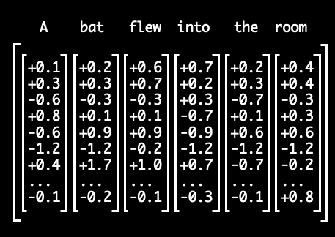

Attention Head:
Identifies which words interact with each other
Attention head

Slide 33
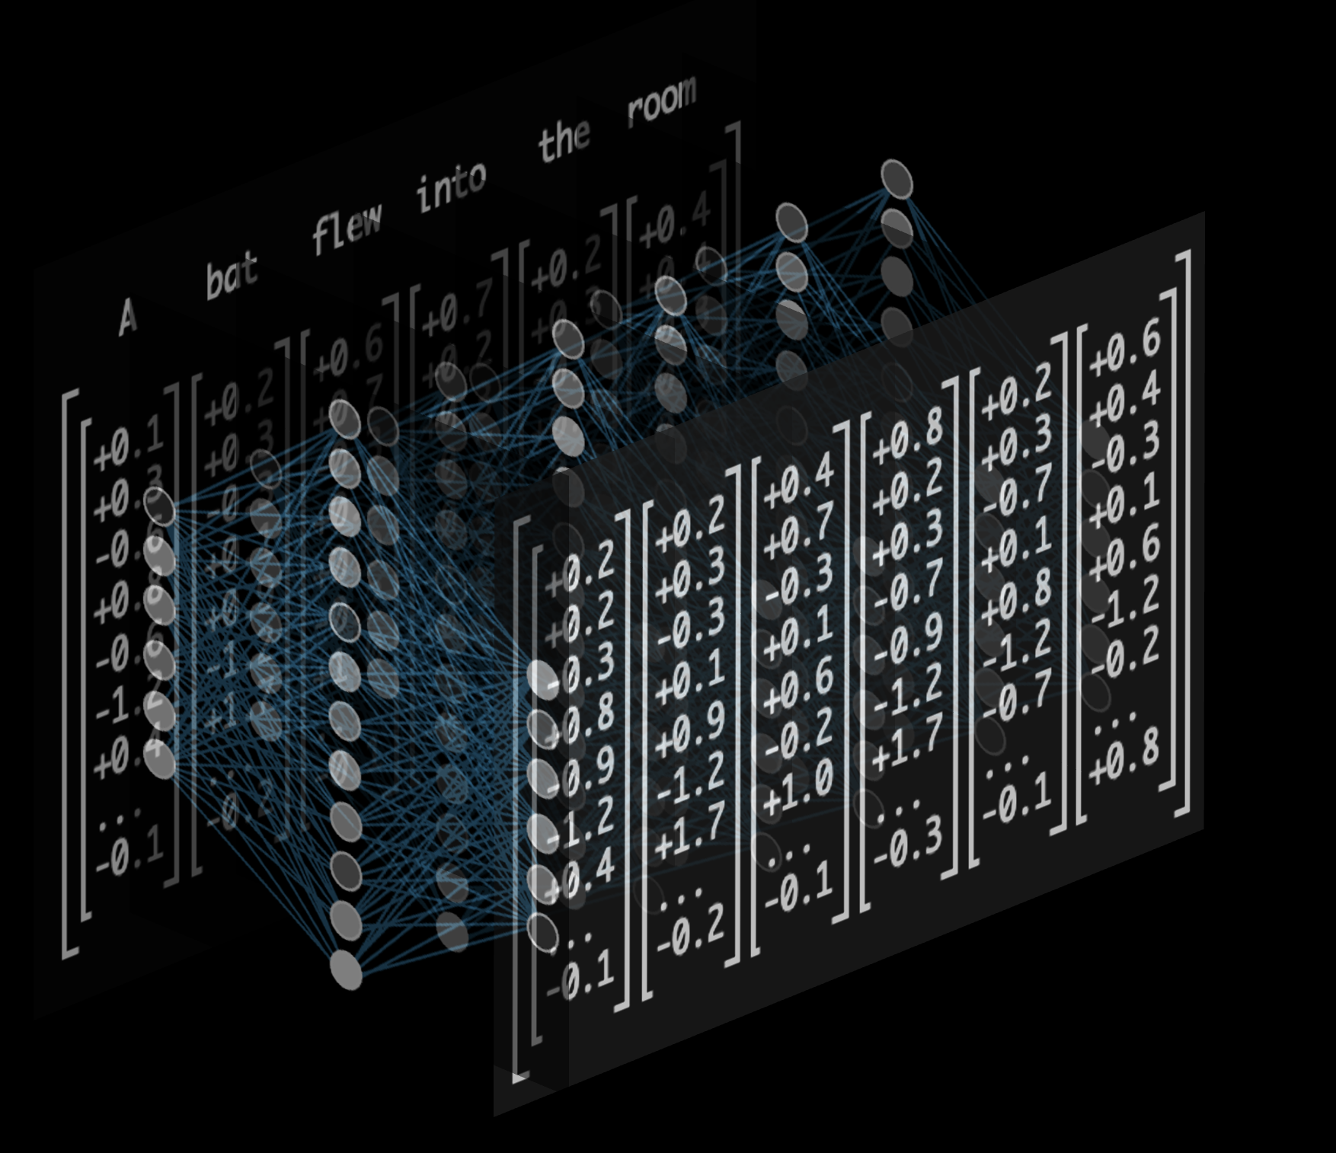
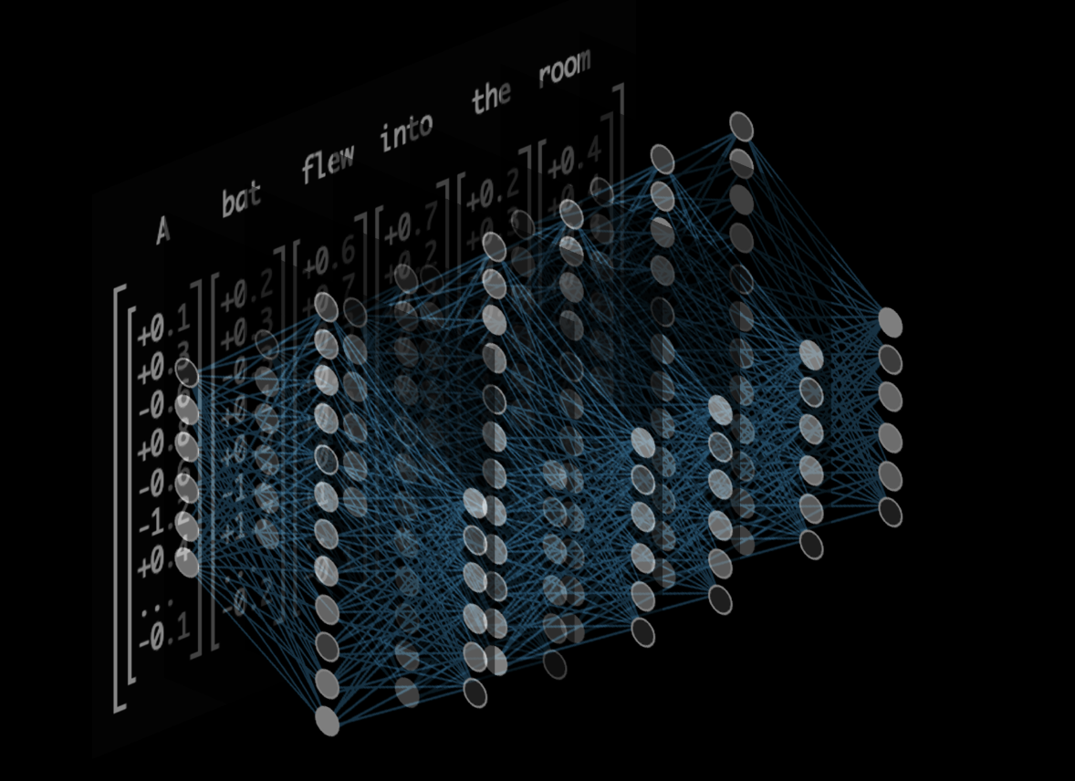
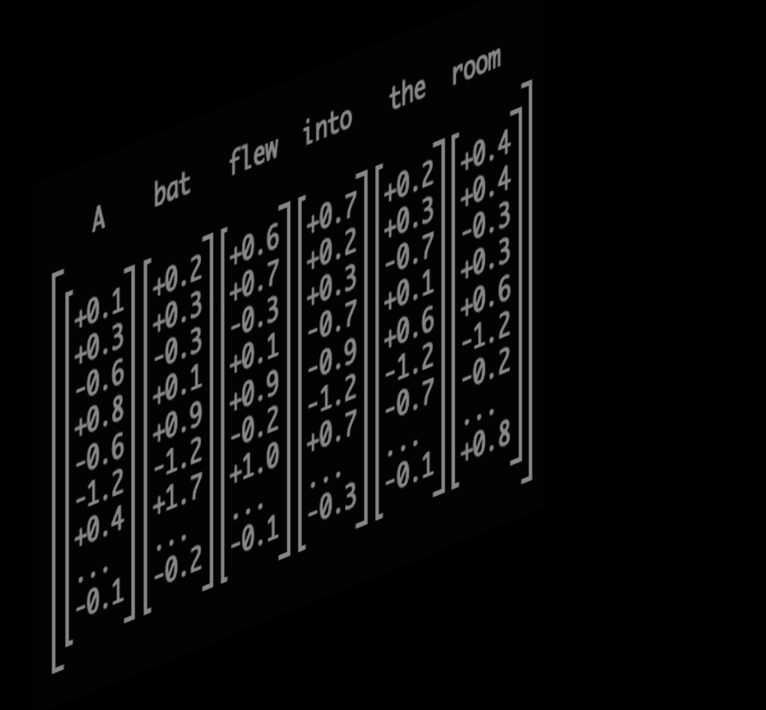
Multilayer Perceptron (MLP)
Attention head
Updated embeddings
(learn new semantics)
A bat flew into the room
vs. A player at the bat

Slide 34
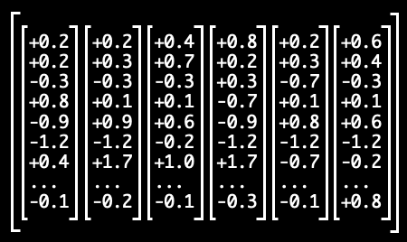
Word embeddings can capture semantic relationships,
such as size (green arrow) or gender (yellow).
Byte
Megabyte
Terabyte
Aunt
Uncle
gender
size
Notably, these learned representations are NOT encoded on a single axis,
but distributed across many dimensions of the embedding matrix

Slide 35
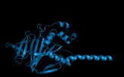
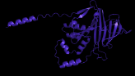
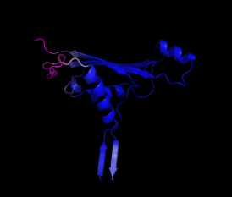
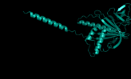
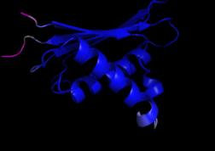
Similarly, protein language models can capture latent features:
M W G Q R A
Cellular location
Size of tensor :
N X Len X 1280
Structural features

Slide 36
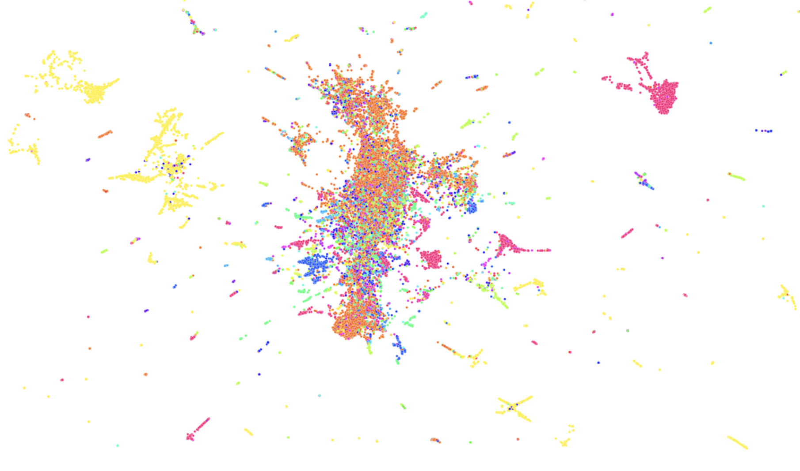
MLEQPYVFIKRSD
MLEQPYVFIKRSD
MPYVFIKRSDWA
Reduced dimension space
MSXNGPQNQRD
MESLVPGFNEKTH
MSEEEALSQLKNL
UMAP
Size of matrix
N X 1280
(1280 dimension)
Similar Function
Similar structure

Slide 37
How can we use LLMs?
Significance
01
02
03
04
DISCOVERING NOVEL VIRUSES/VIRUS-HOST INTERACTIONS
IDENTIFYING KNOWN VIRUSES
REDUCE RELIANCE ON CULTURED BACTERIA FOR VIRUS GENOME SEQUENCING
CHEAPER AND
FASTER VIRUS IDENTIFICATION
Notes:
- For our project we want to create an LLM using millions of virus and bacteria genealogical data to predict likely sequences that make up virus sequences which can not be determined through typical sequencing means

Slide 38
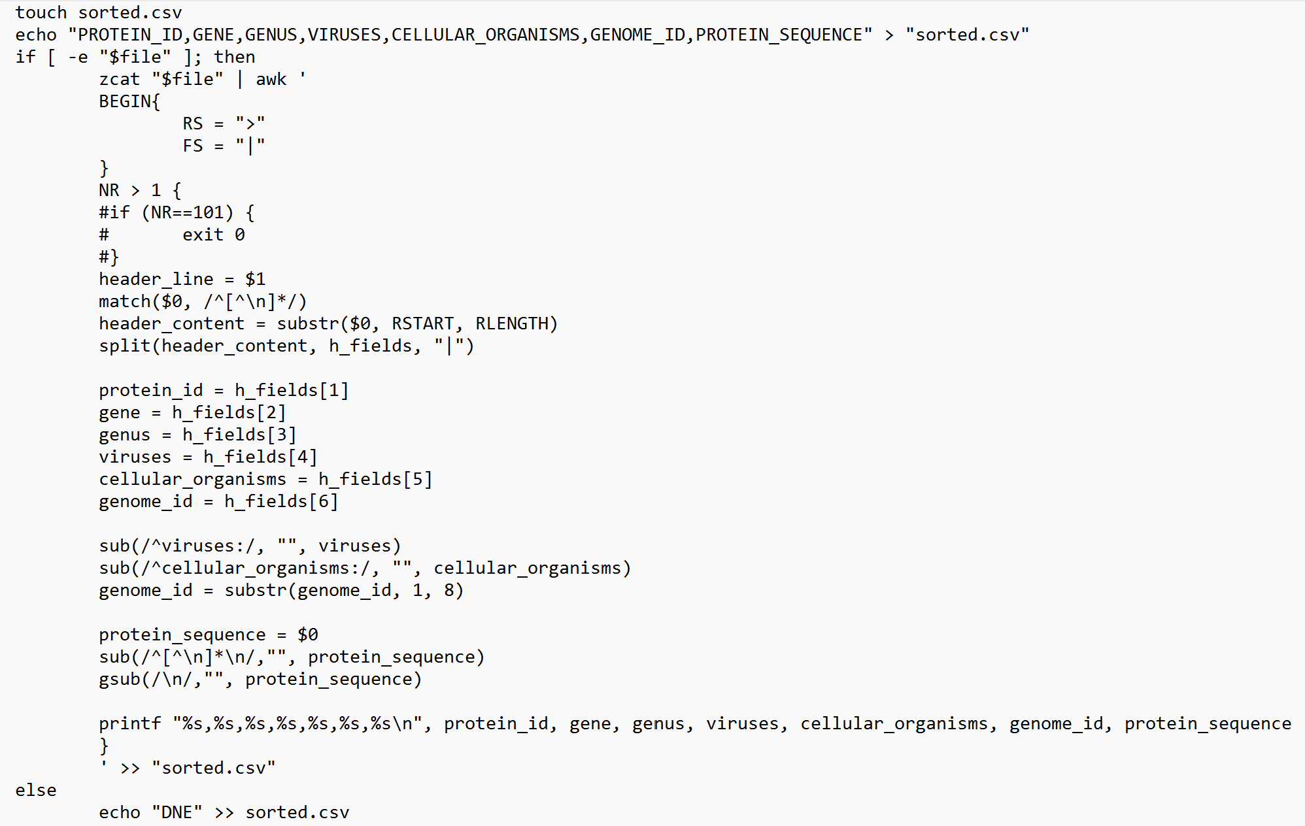
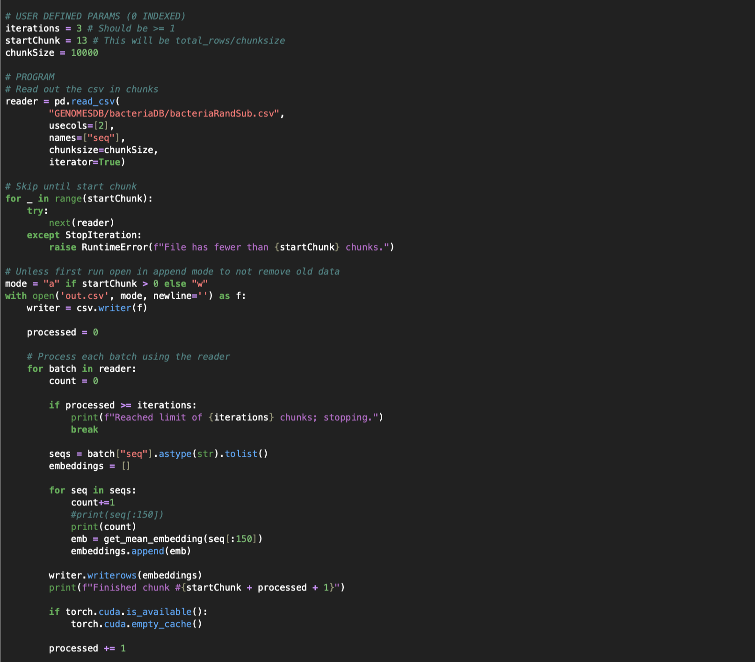
Data collected from the NCBI and Virus-Host Database
Table entries parsed from FASTA files and filtered to 2M entries
Virus/bacteria protein sequences embedded into vectors
Notes:
Talk about Laguna

Slide 39
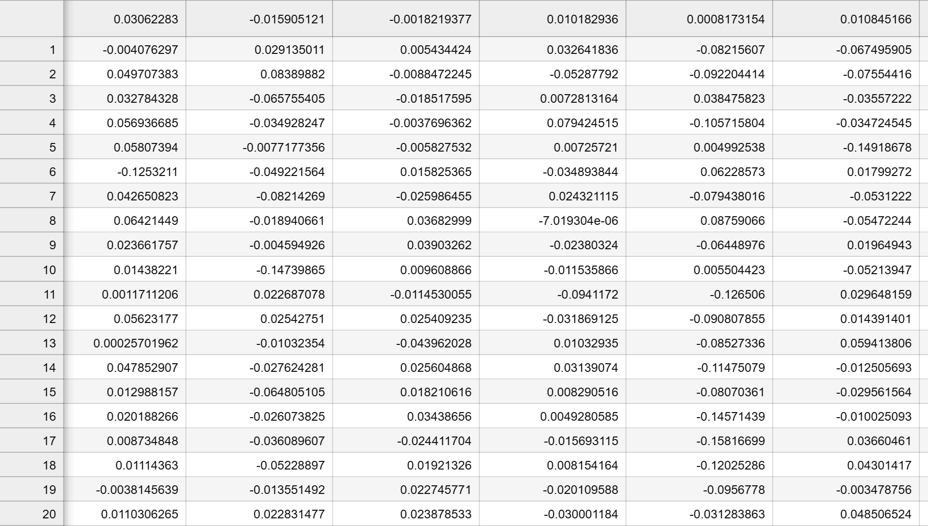
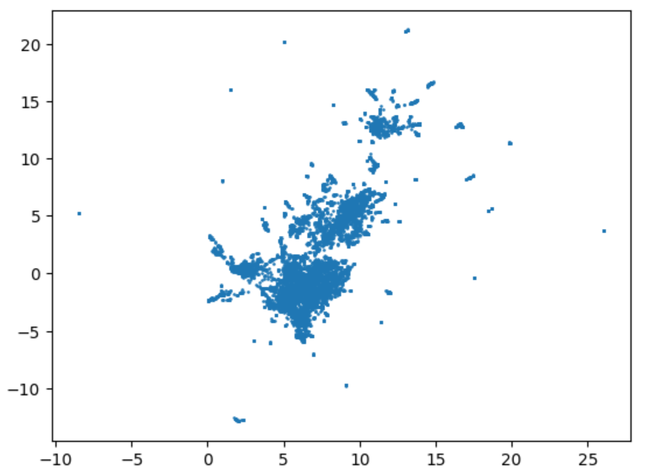
Our Dataset

Slide 40
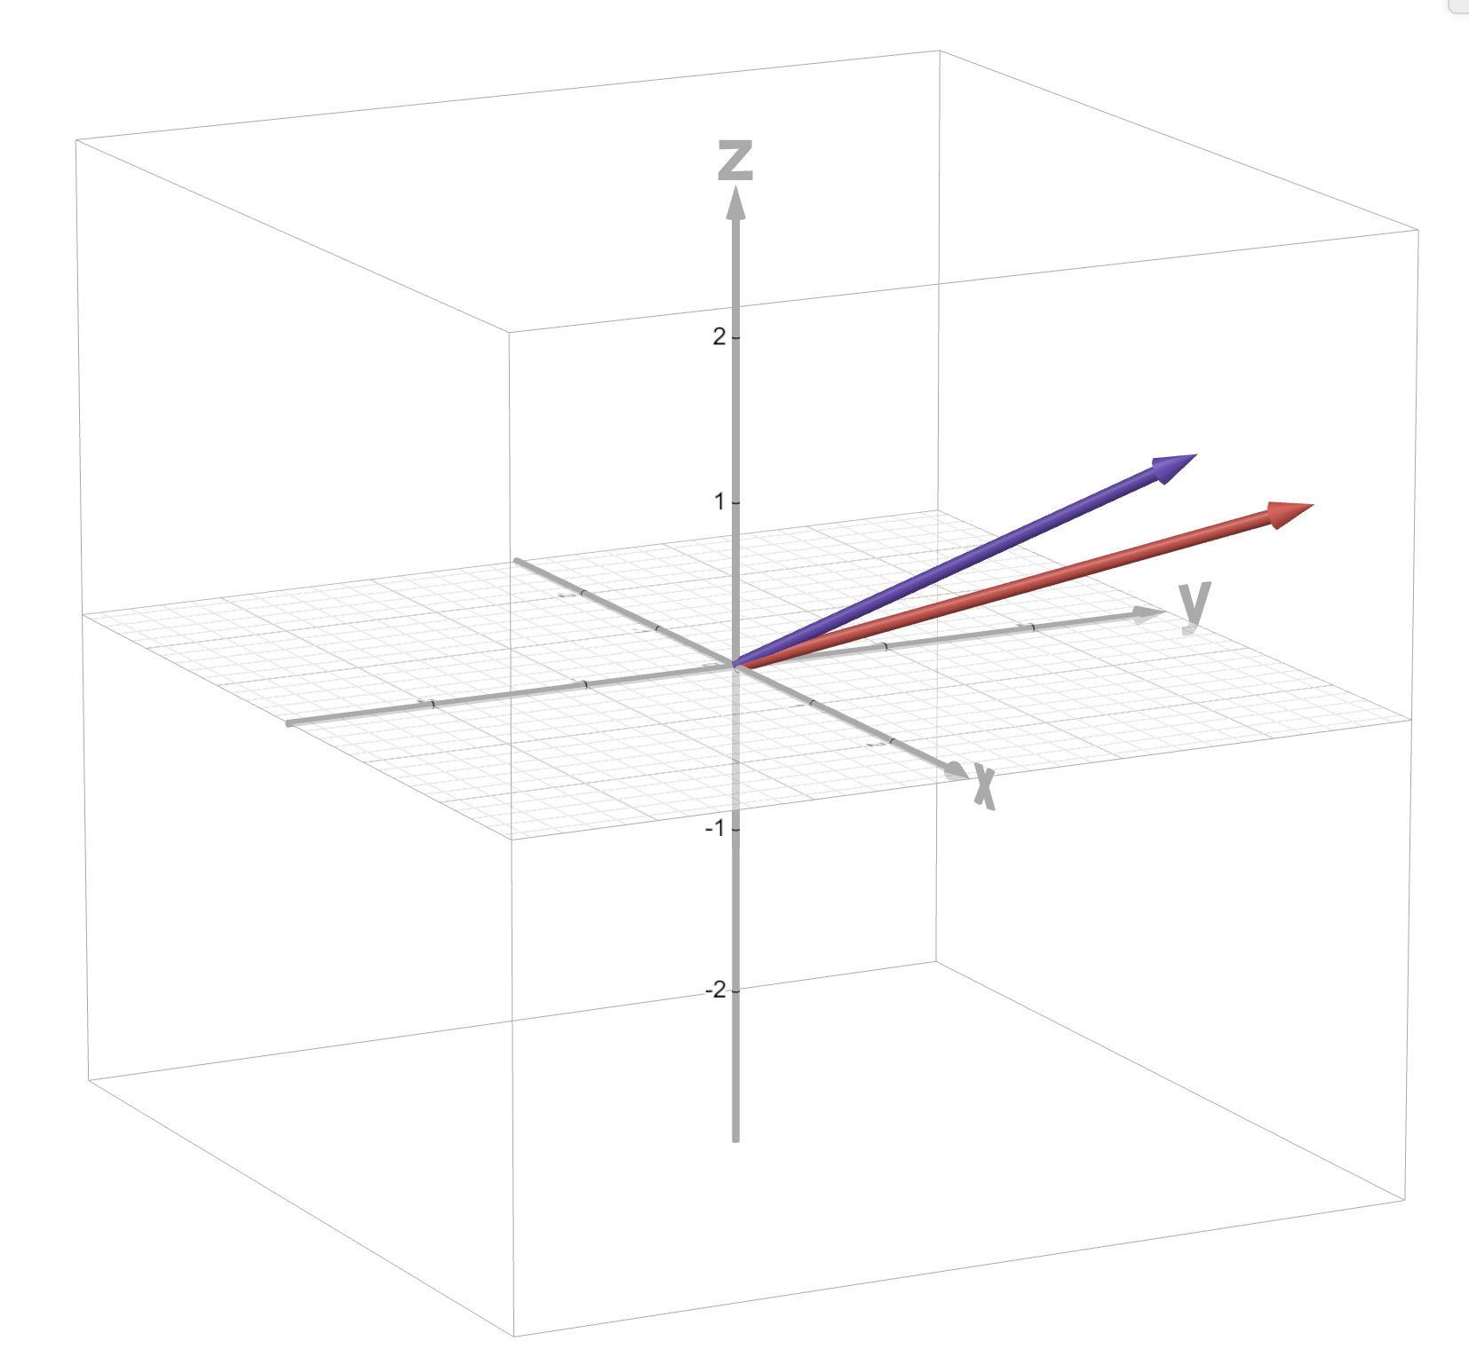
Large Language Models
Data embedded into high dimensional vectors
Apple
Apple Pie

Slide 41
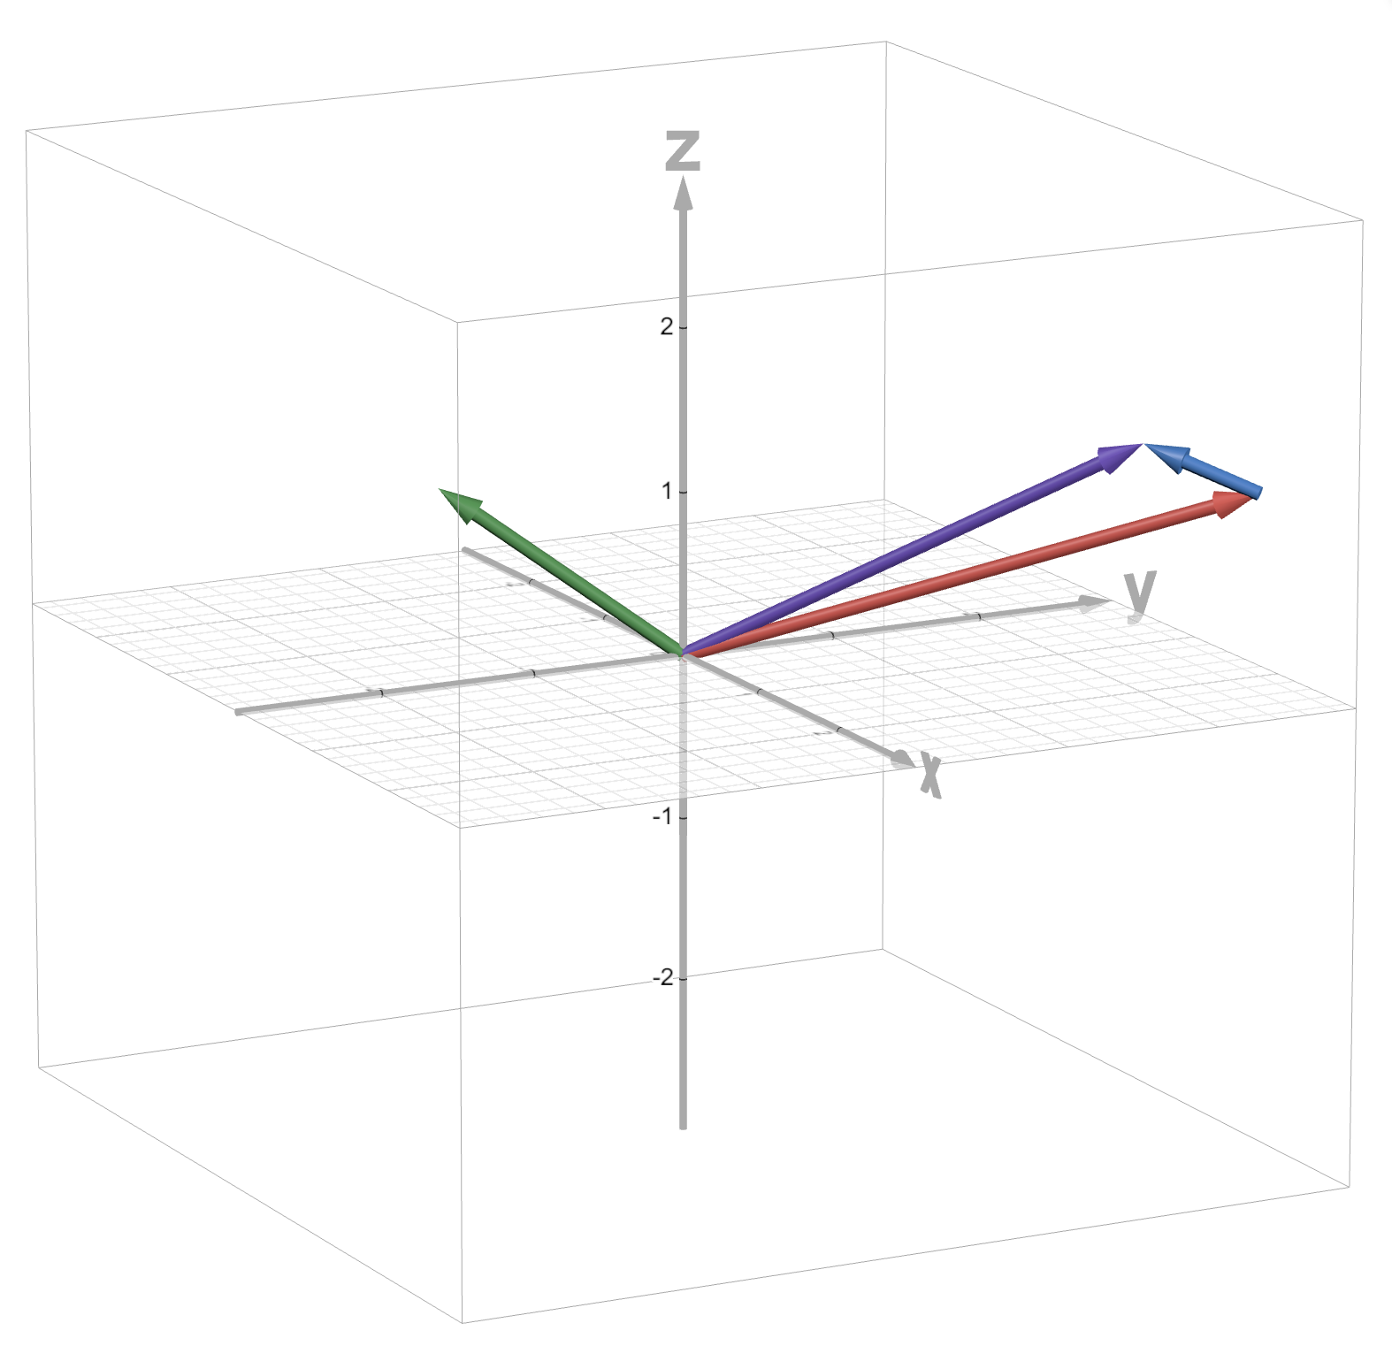
Large Language Models
Vectors are related to each other by spatial proximity
Organized in tensors
Apple
Pie
Apple
Apple Pie
Car
Apple Pie

Slide 42
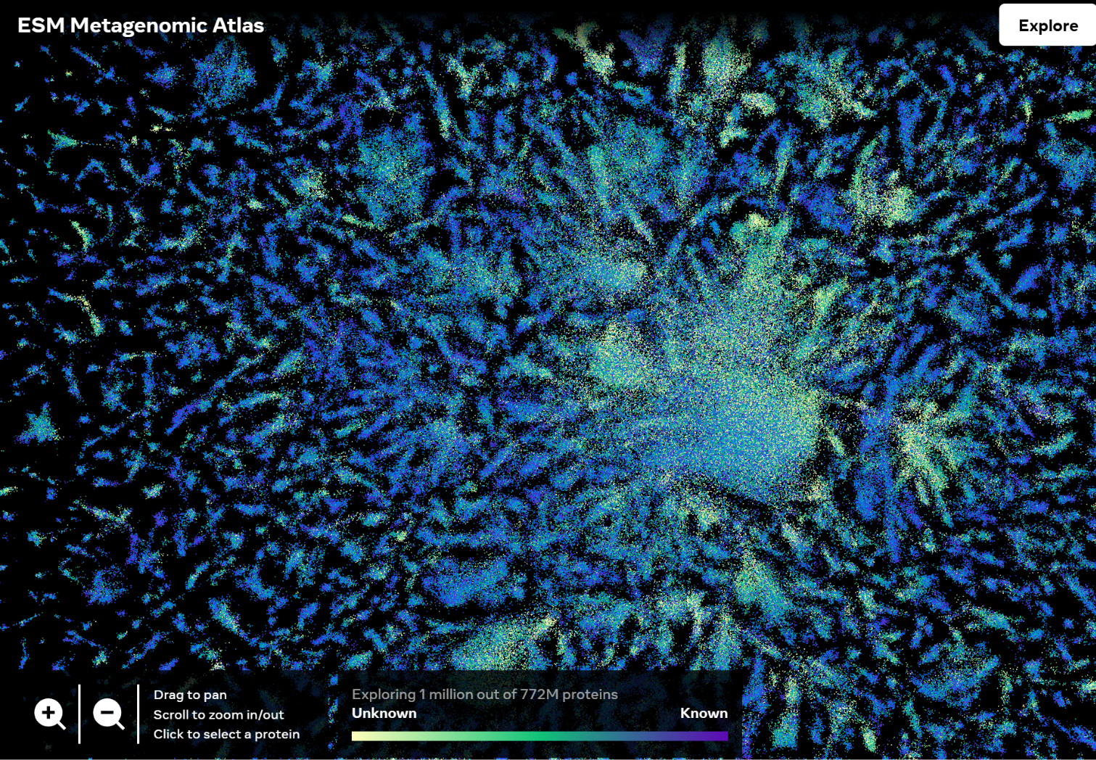
Large Language Models
Interpreted by weights in a trained model
Our output will “clusters” of genomic data
Hidden Layers
Input
Output
ESM Metagenomic Atlas: Meta Ai. ESM Metagenomic Atlas by Meta AI. (2023, March). https://esmatlas.com/explore?at=2.1021690368652344%2C-0.2285318821668625%2C10.756548546458907

Slide 43
